Slide 1

Tensorflow Analysis
Rashmi Tripathi,
Knowledge Discovery and Management
Dept. of Computer Science
School of Computing and Engineering
University of Missouri – Kansas City

Slide 2
Agenda
Introduction
Solution
Tools and technologies
Architecture
Dataset Creation
Screenshots
Future work

Slide 3
Introduction
Problem Statement
Everyday new sourcecodes are getting launched in the market
Github promotes open sourcecode sharing
How to get equipped with latest technology?

Slide 4
Solution
Knowledge graph generation
Any source code follows a pattern
We picked up Tensorflow open source code
It is in python
Python consists of different files in packages

Slide 5






Tools and Technologies

Slide 6
Architecture
RAW DATA
NLP
TFIDF
Topic Discovery
Triplets Extraction
Stop words removal
Ontology Creation
Question
NLP
Get answer
Display Answer

Slide 7

Dataset Creation
Created our own dataset using one main package of Tensorflow. It contains 60% of code.
Python files may contain
/tensorflow/python/ops
Functions
classes
Imports
Variables

Slide 8
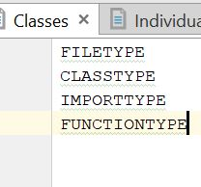
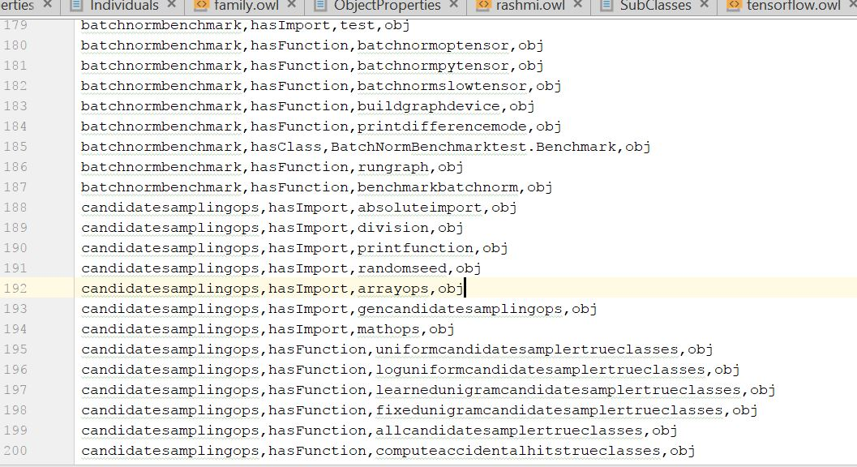
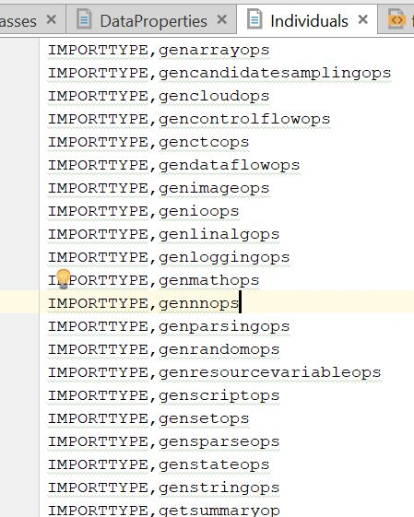
Dataset view

Slide 9
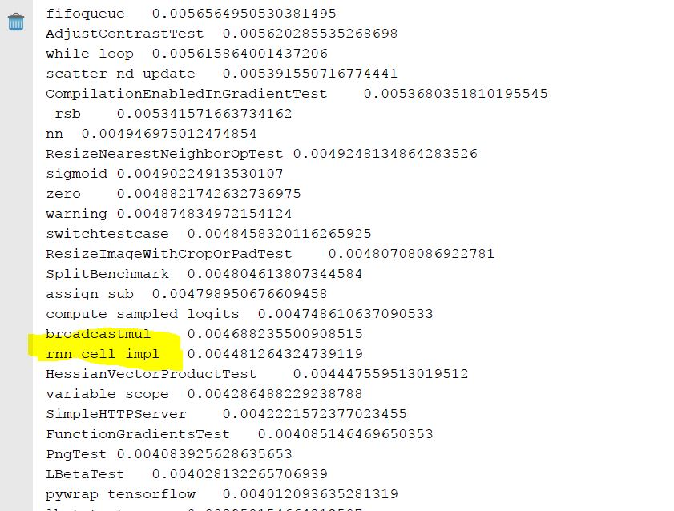
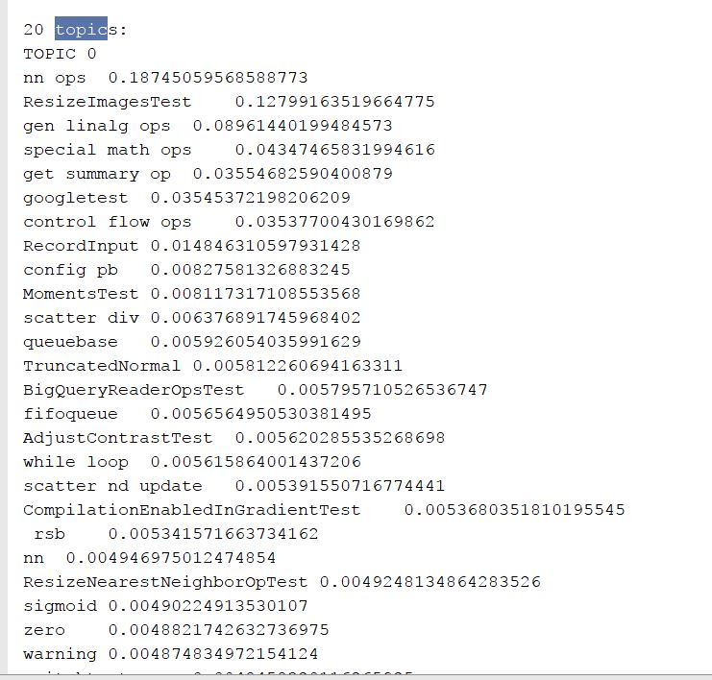
LDA : Top 20 topics

Slide 10
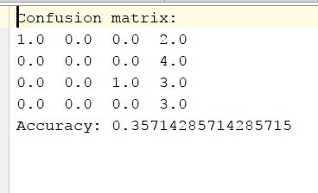
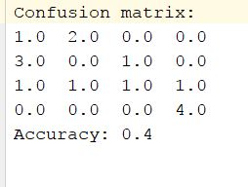
Classification using Random Forest and Naïve Bayes
Naïve Bayes
DT

Slide 11
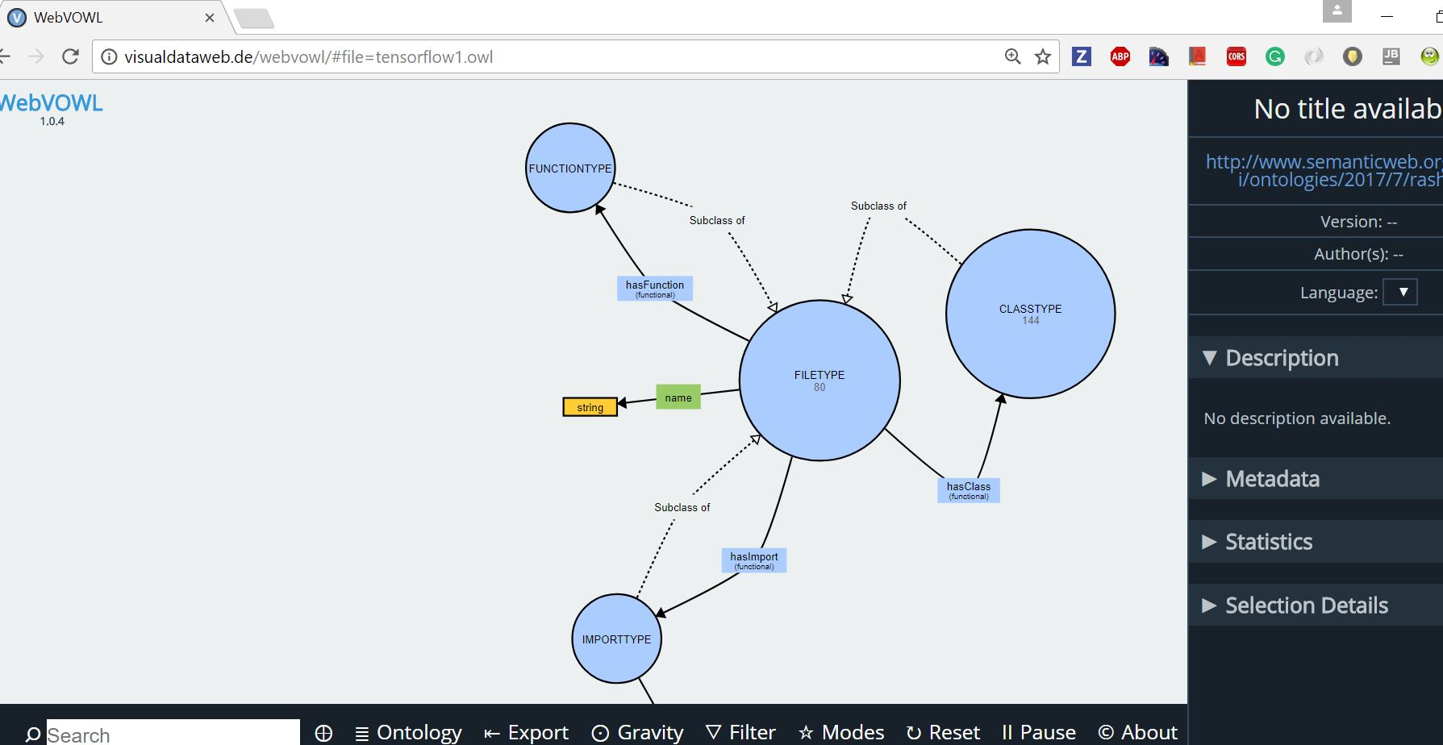
Output- Ontology

Slide 12
Triplets Generation- Manual one

Slide 13
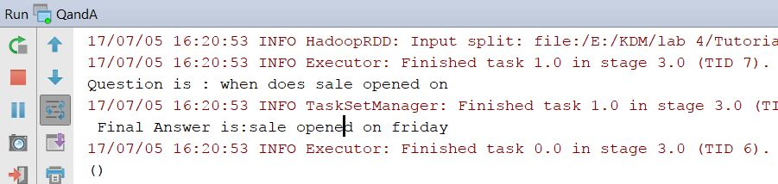
With BBC news dataset
Our Q/A model was successful

Slide 14
Future Work
As variables are random in nature, need to figure out a way
How to treat inner classes
What about other members of python file ?How to extract information from them.
How to work with complex ontology with more than 1000 individuals

Slide 15


Slide 16


